Slide 1
User Engagement Analysis
Showwcase
Shubham Mahajan

Slide 2


Task
Every time a user logs into their Showwcase account, a new session begins. In each session, we track how and where a user is engaged on the platform. Analyze the data to provide better understanding "user engagement" on the platform in the month of October 2019

Slide 3
Dataset Showwcase_sessions.csv File
Dataset consist records of each session a user completes and has following columns:
● session_id → unique identification number for each session
● customer_id → unique identification number for each customer
● login_date → the date the user logged into Showwcase for that session
● projects_added → boolean if at least one project was added
● likes_given → boolean if at least one like was given
● comment_given → boolean if at least one comment was given
● inactive_status → boolean if the user was inactive or idle
● bugs_occurerd → boolean if a user ran into at least one bug
● session_projects_added → number of projects added
● session_likes_given → number of likes given
● session_comments_given → number of comments given
● inactive_duration → number of seconds a user was inactive or idle
● bugs_in_session → number of bugs a user ran into
● session_duration → number of seconds a user was logged for that session

Slide 4
Approach
Decided to use Python programming language for Data preprocessing and Exploratory Data Analysis
1
Visualized data on tableau to provide graphical representation of insights
2

Slide 5
Analysis in Python:
Started with data cleaning and preprocessing in which null values were handled. Also, Some columns had non-required floating datatype which was converted into int.
Derived new column “Weekday” to get insight of customer engagement on the day of week.
Generated dataframe to analysis customer data by capturing all metrics for each customer. For e.g. this table shows total likes given by particular customer, total active time , inactive time, total projects added.

Slide 6
High Performance Insights
Saturdays have gotten in the most number of customers on the platform.
Customers having more bugs tend to have high inactive duration. One inference can be inactive duration makes session to be expired and it got counted as a bug.
26th October generated 247 likes in total being the highest record for October 2019.
Most number of projects were added on Saturdays and Tuesdays

Slide 7
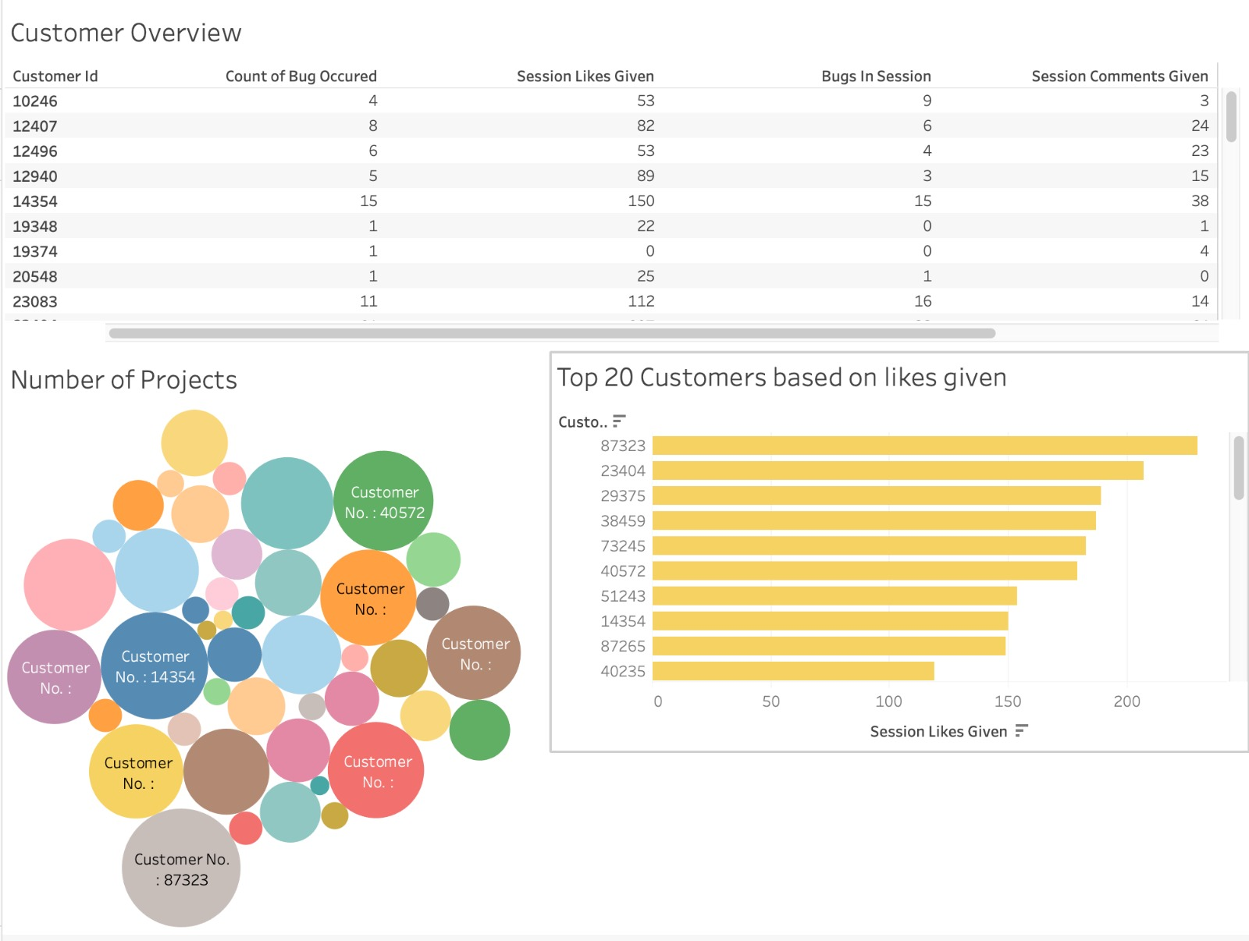
Customer centric Dashboard View

Slide 8
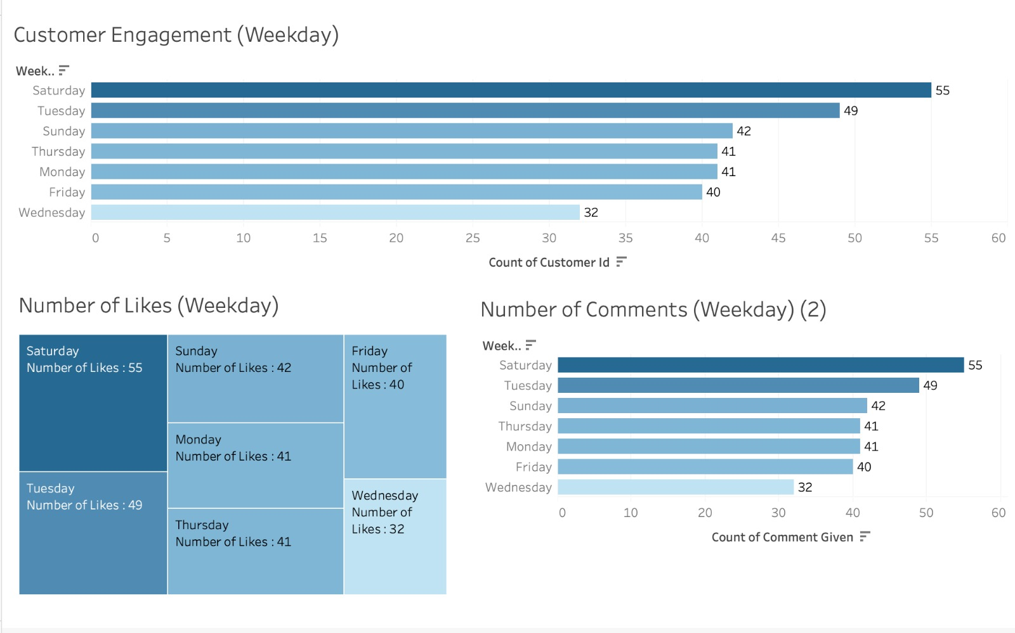
Weekday centric Dashboard View

Slide 9
Few Insight centric Visualizations

Slide 10
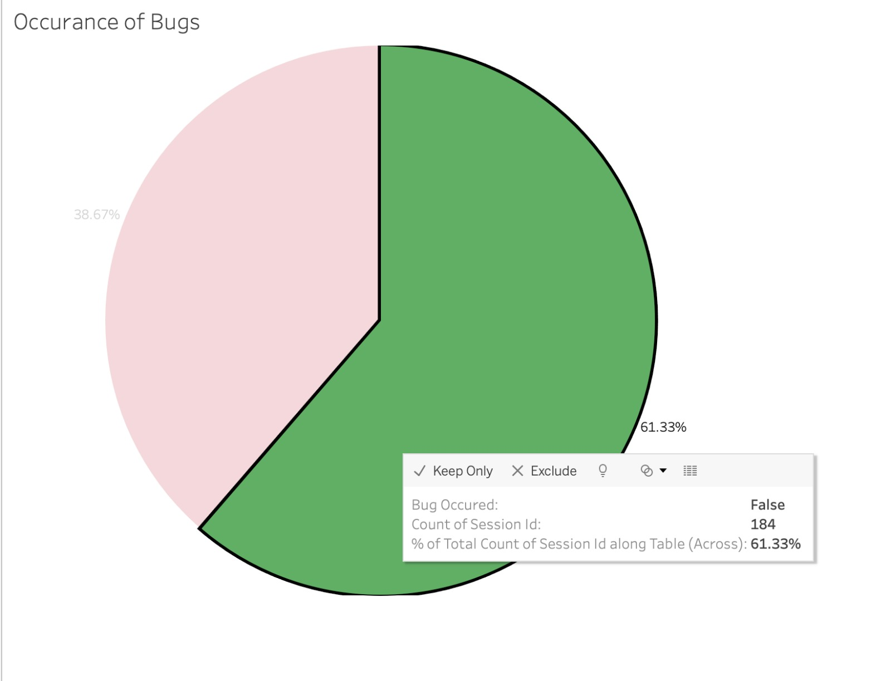
Occurrence of Bugs in Projects for Customers

Slide 11
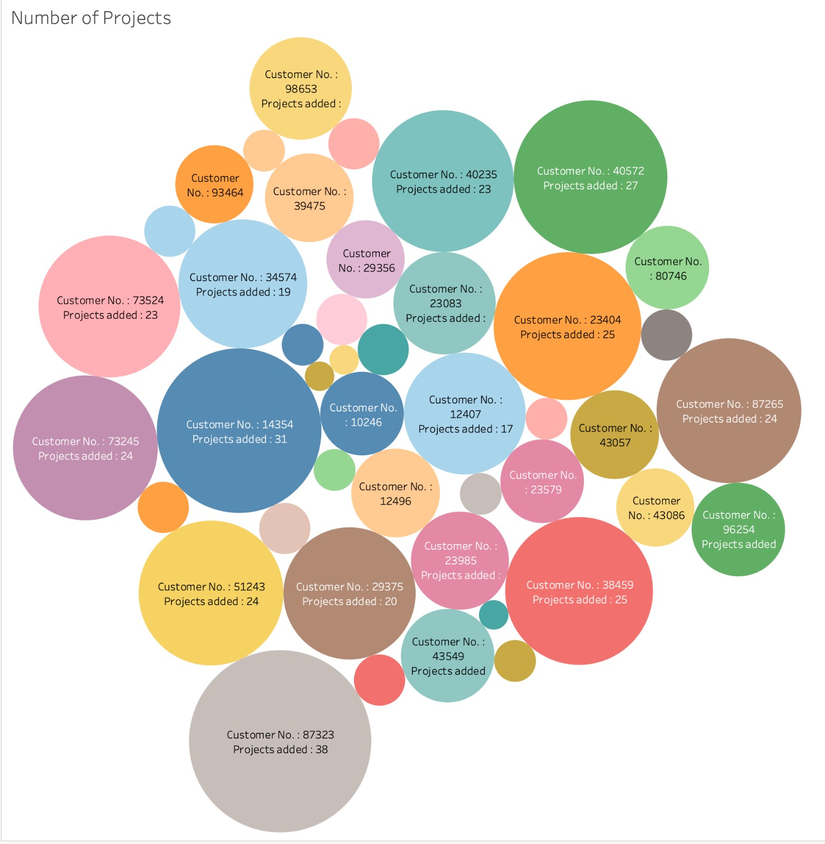
Clouds for Number of Projects Recorded

Slide 12
THANK YOU!

